Slide 1
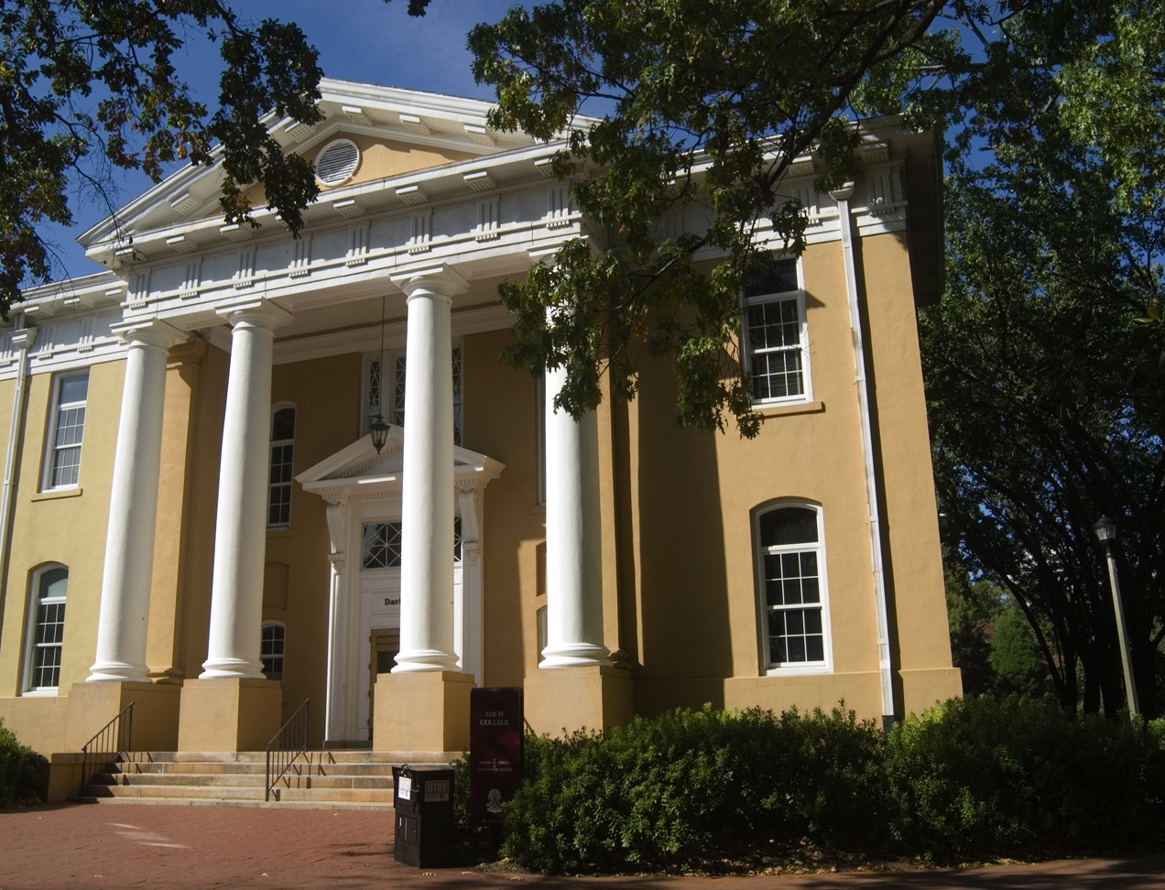
Dr. Sam Hastings
hastings@sc.edu
Library & Information Science
State of the School 2015

Slide 2
What we say about ourselves
The School of Library and Information Science has dramatically expanded its academic and community outreach programs to match the rapidly evolving information landscape. Long a highly regarded professional program for librarians and media specialists, we have added undergraduate and doctoral programs. We have been a leader in distributed learning with classes on campus and online across the state and across the country. The school is a literacy champion through our South Carolina Center for Children’s Books and Literacy and Cocky’s Reading Express™ reaching children and schools across the state.

Slide 3
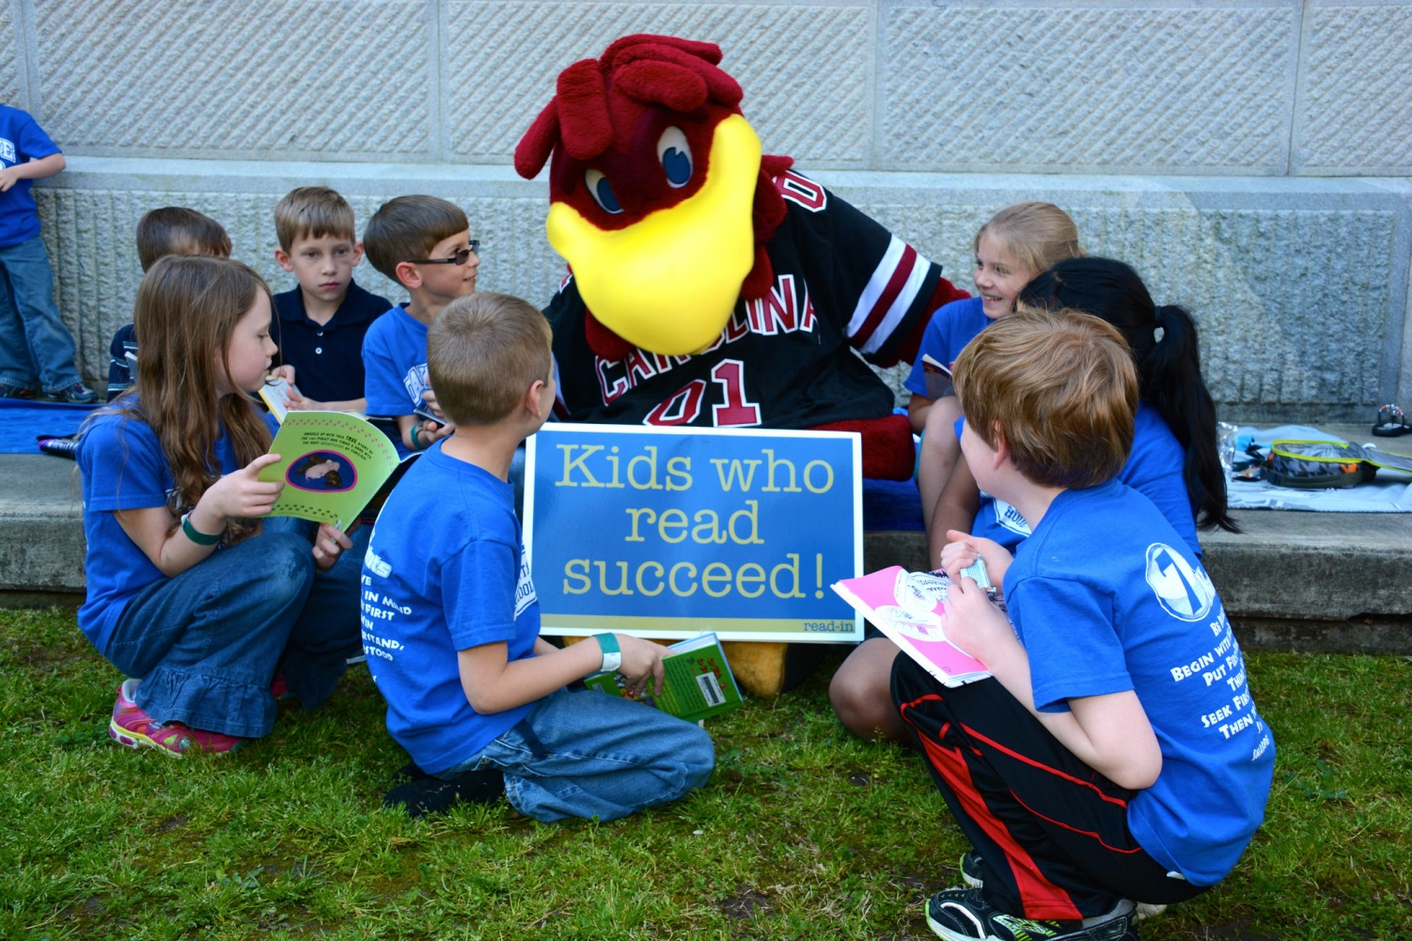

Slide 4
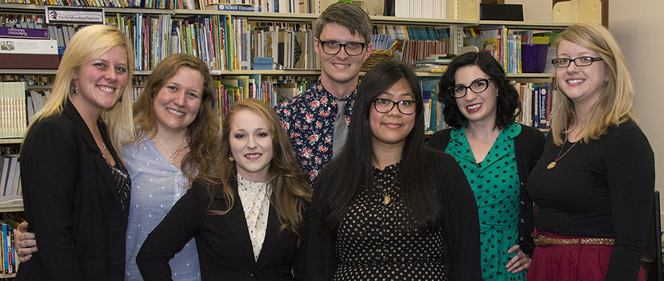
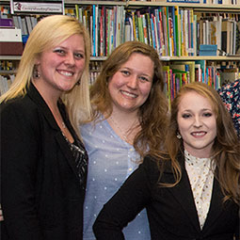
LISSA Wins Student Chapter of the Year from ALA

Slide 5
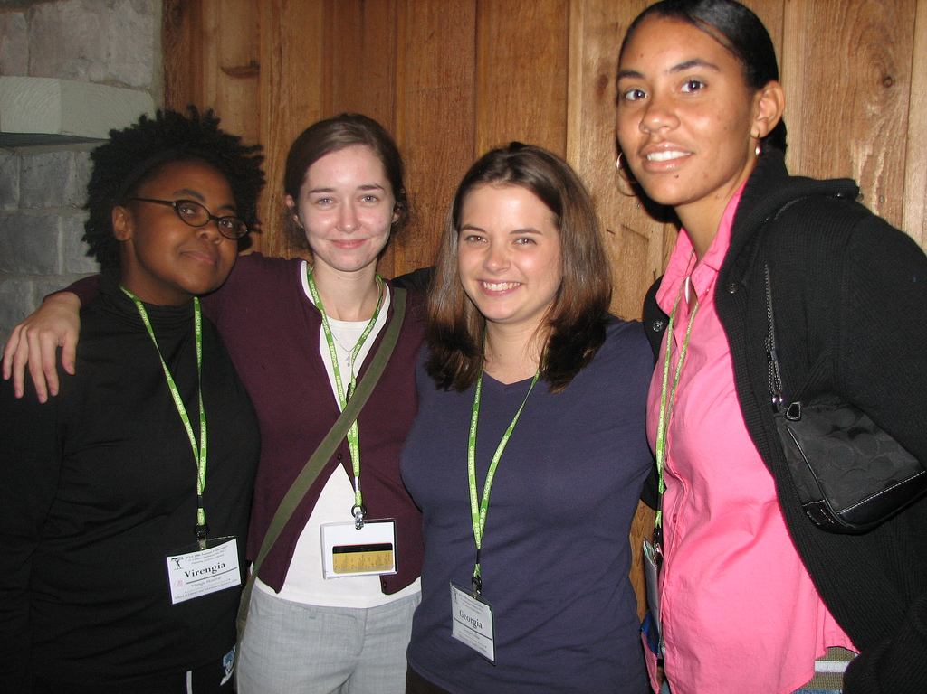

Slide 6
30 years of Distance Education/Learning
Alumni from cohorts in Maine, Virginia, West Virginia, Georgia and throughout South Carolina
Current students from around the world
New technologies used every day
More than 4500 alumni
IBM partnership with Watson to design new ways of learning

Slide 7
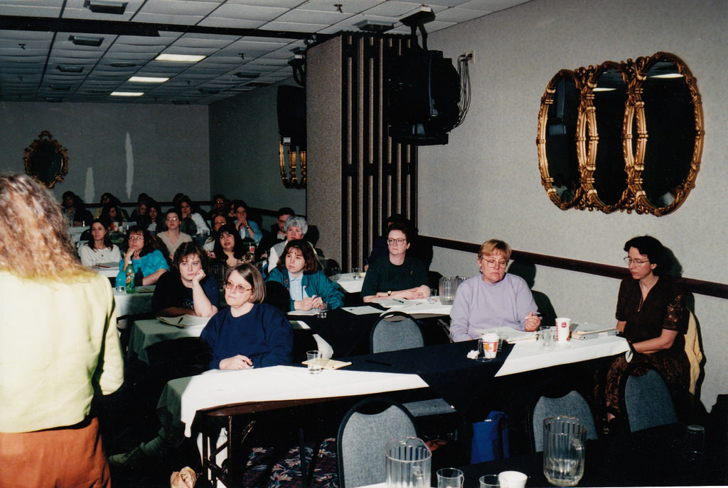
WVA Orientation 1998

Slide 8
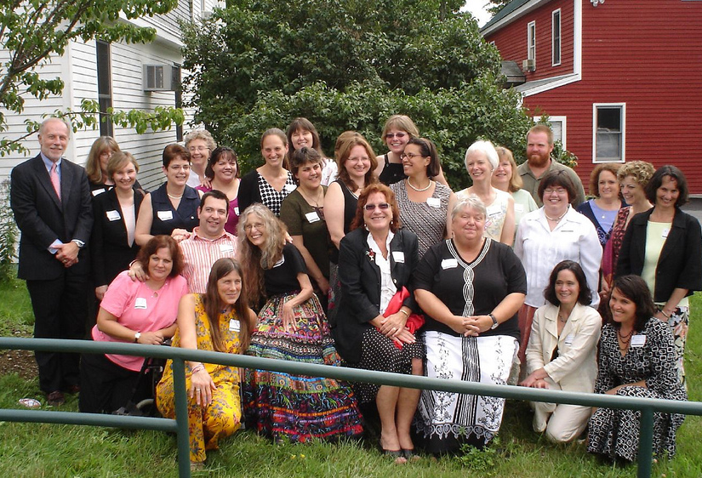
Maine Graduation 2008

Slide 9
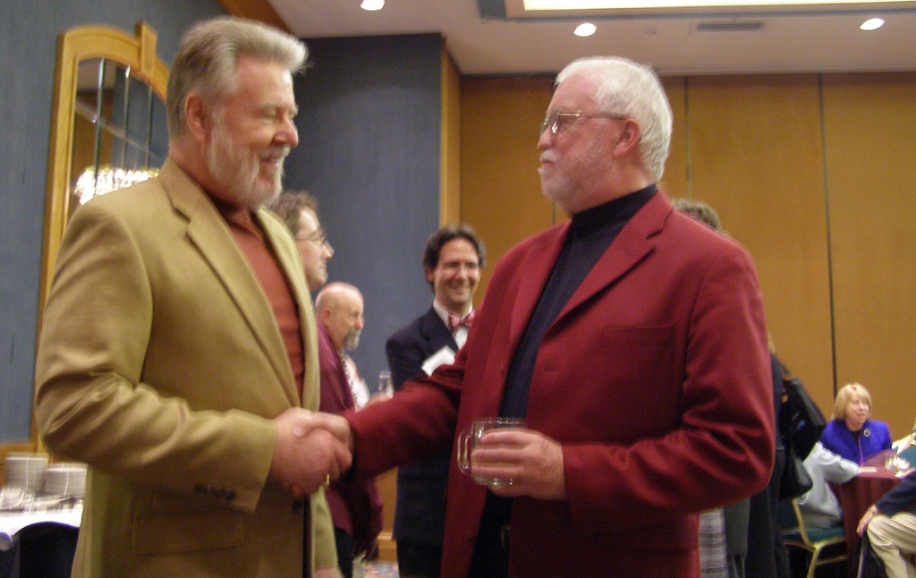
SCLA 2005

Slide 10
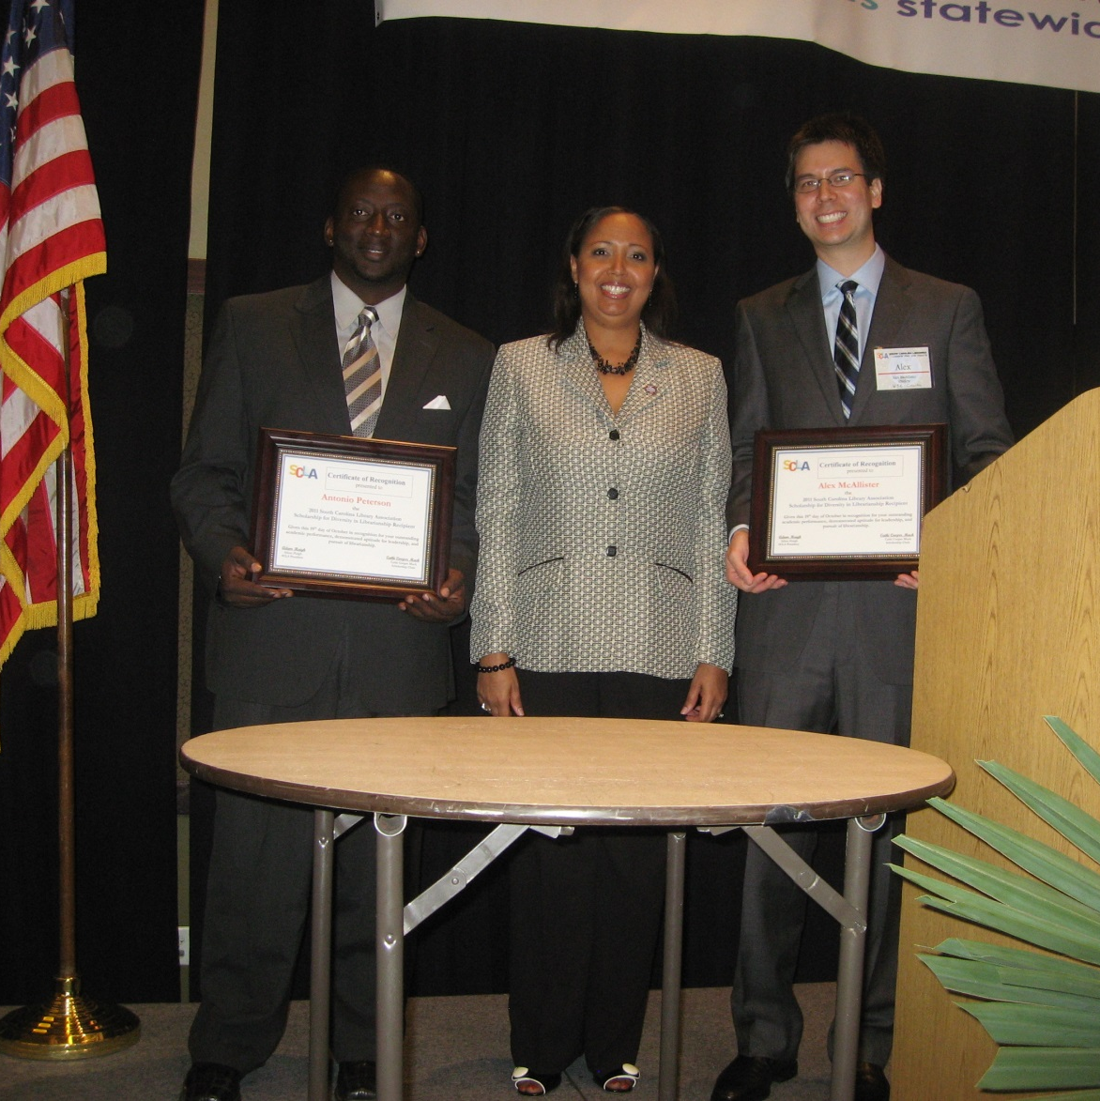
Diversity Scholarship Awardees
SCLA 2011

Slide 11
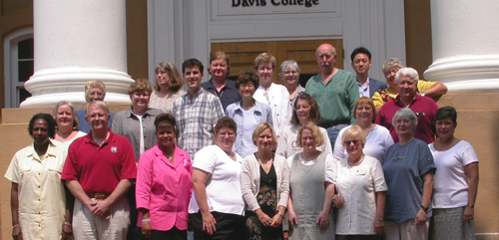
SLIS Ancestry

Slide 12
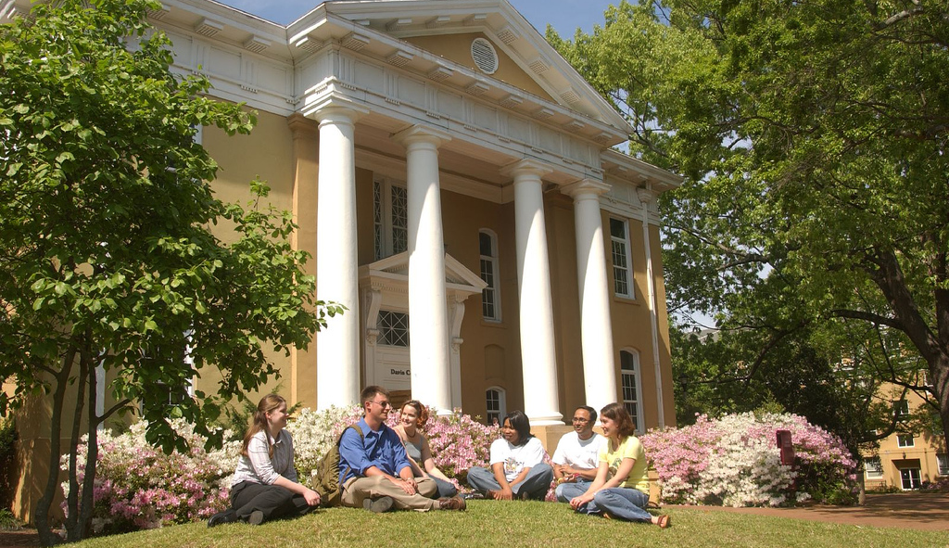
Forever to thee. . .

Slide 13
5 Year Goals
Goal 1: Create a more effective learning environment in appropriate facilities for the college.
Strategy for 2014-2015:
Restoration work on the exterior of Davis College is completed. SLIS created an undergraduate lounge and computer lab in the basement of Davis College to serve our growing BSIS population of students & redesigned our MLIS Computer Lab. ADA Bathroom coming this year.

Slide 14
5 Year Goals (continued 2)
Goal 3: Raise the minority participation in all aspects of the college.
Progress 2013-2014:
SLIS recruited in most of the HBCUs in the southeast for second year, increasing diversity in student population by 20%. SLIS students presented at the ALA Librarians of Color conference, the ALA Black Caucus, and Reforma. We secured two spectrum scholarships for students of color.
Five SLIS faculty presented papers at three conference based on research and service for underserved populations (Albright, Arns, Copeland, Gavigan and Martin)
Strategy for 2014-2015:
SLIS will continue recruiting from HCBUs and continue to encourage faculty and student research that emphasize service for underserved populations. Establish LLEAD, a laboratory for leadership in equity of access and diversity.

Slide 15
Strengths
Literacy outreach programs continue to improve reading activity throughout the state and funding has increased for CRE and community programs. 10 year anniversary for CRE.
Young Palmetto Reader imprint added to the University of South Carolina Press.
Quality of the Faculty and Staff. Faculty productivity continues to increase in both publications and funding. Staff rocks!
Doctoral program is growing and beginning to receive national attention with the success of our first group of graduates.
BSIS is a degree that is important to the economic development of SC.
MLIS placements continue to be above 90%. We have the best students in the universe.
Our spirit of diversity and inclusion as reflected in our faculty, staff and students.
Contracted for third Annual Review of Cultural Heritage Informatics (ARCHI)
Willingness to collaborate and serve our communities.

Slide 16
Weaknesses
Enrollment in the MLIS continues to decline which is reflected in national trends. Need to be more competitive in our tuition structure and add additional recruiting efforts.
Expansion of the BSIS continues to be slow due to lack of faculty resources.
Increased faculty productivity requires additional staff support and strategy may require research director or similar expertise.

Slide 17
Internal Challenges
Accreditation this year and visit in 2017
Need to formalize review of adjunct instructors and teaching assistants
Current placement data needs to go on web
Funding
Need for adequate support staff including grant assistance
Continue to insure that new hires have resources needed to succeed

Slide 18
External Challenges
More and more SLIS programs are available online
Competitive tuition is dependent on central decisions
Need increased scholarship opportunities
Funding for doctoral students
External funding sources decreasing
Faculty & Staff raises

Slide 19
We can do it!
Continue to build on our strengths
Continue to increase our diversity in all ways
Remain committed to the principals, values and ethics of our fields
Prepare for re-accreditation
Prepare for transitions in leadership

Slide 20
Help us design the future
What is the most valuable lesson you learned while getting your MLIS?
What is the most valuable lesson you learned in your first professional position?
How can we recruit more students from underserved populations?
Describe what your library will be like in 20 years.

